Slide 2
Introduction to Github

Slide 3
Why, What, How?
Why: GitHub is the world's largest software development platform
What: Learn how to use GitHub as Version Control System to collaboratively work together with other programmers
How: 1. Get to know GitHub in the Browser (today)
Create repository for daily protocols
Create markdown file
Create branches and Pull requests
2. Learn how to sync your local machine with git command line tools and GitHub (later)

Slide 4

Git
What is Github?
Cloud storage for code with ‘git’ version control system
Collaborate effectively online
Open-source community and contribution
Follow others, find and star interesting repositories
Show others what you did, invite to collaborate and collaborate yourself
Demonstrate that you are actively working on projects
Version control system

Slide 5
GitHub
What does GitHub do?
In GitHub, Git repositories are hosted
Collaborators can store files belonging to one (or several) project in a repository
Repositories can belong to individuals or organizations
Repositories can be publicly available or only to its collaborators
Administrators can manage access to repositories for individuals and teams
GitHub simplyfies Project Management via project boards
Git = Version Control System
GitHub = Git repository hosting service, provides web-based GUI

Slide 6
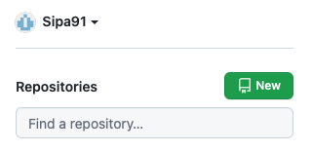
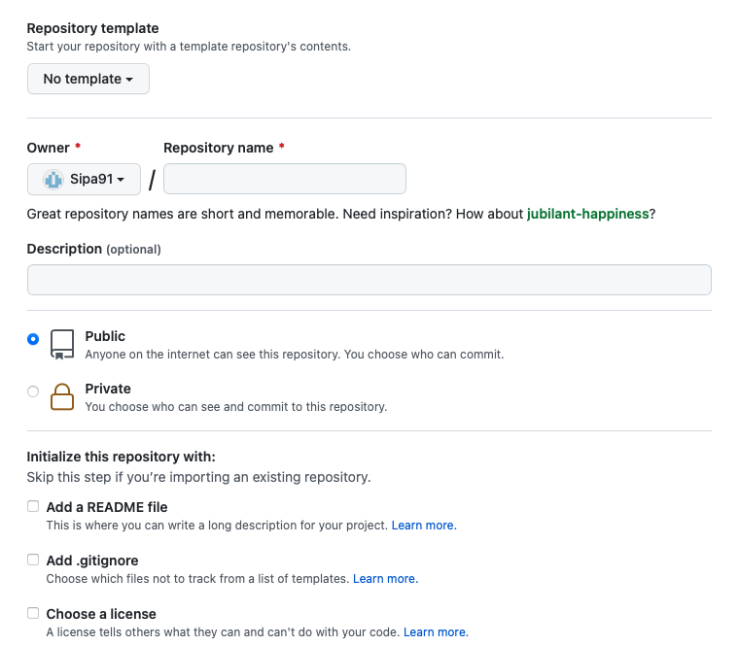
GitHub
Let’s get started
In GitHub, create a new repo(sitory) = storage location for software (files, code , notebooks , …)
Choose “Add a README.md file”
Markdown file containing a description of the repository
Automatically displayed on the front page of repository
Leave “Add .gitignore” and “Add a licence” out for now ...

Slide 7
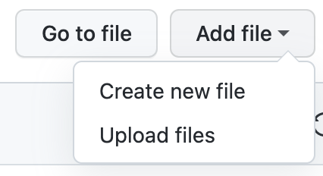
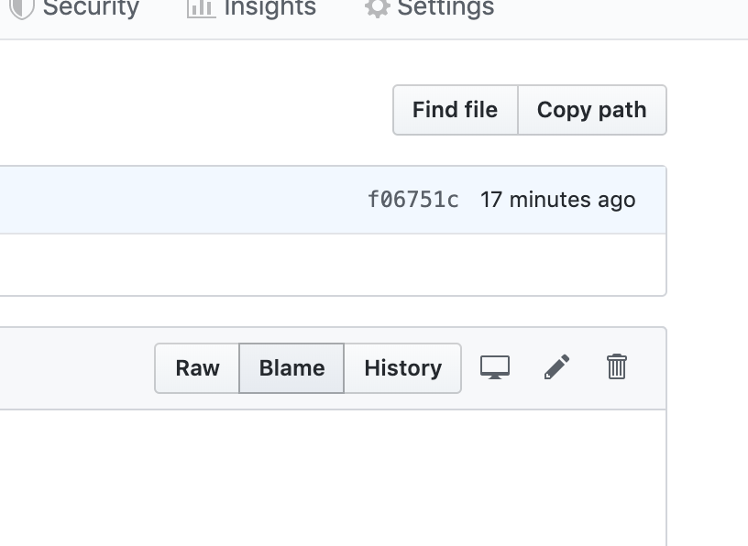
GitHub
Let’s get started
Create some files, upload a picture (any) to your repository
Create a new markdown file - chose a name and as an extension simply use “.md”
Assignment: Write some text including
headings of different levels
an image
a link to your favorite website

Slide 8
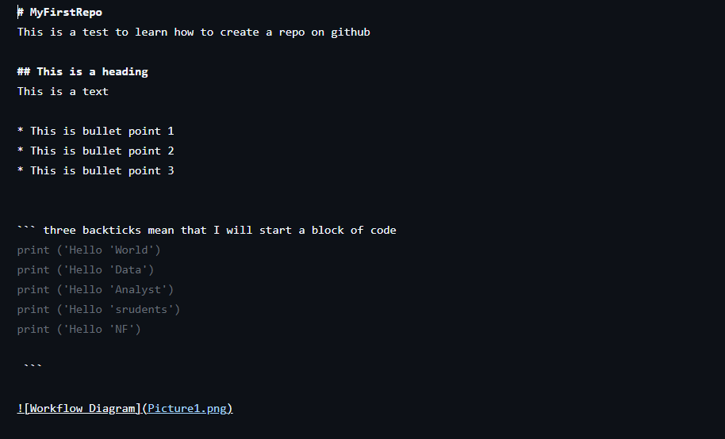
Notes:
This is to teach student how to write headings, bullet points, code snippets and add picture in thier readme files

Slide 9
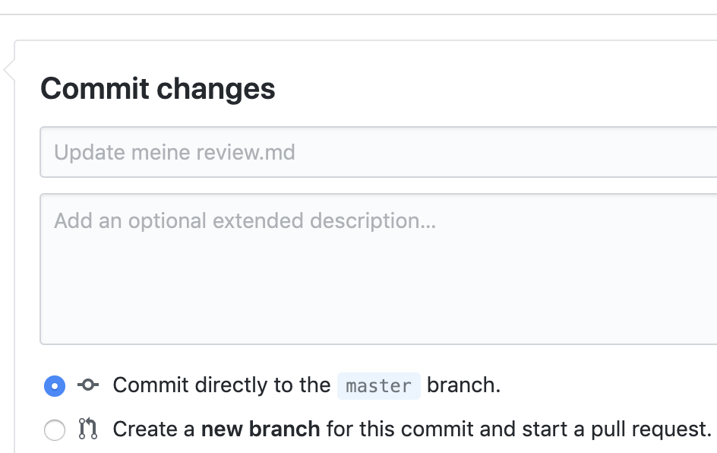
Commit
Let’s get started!
A new version of the code
All the previous code with your changes included
Help your collaborators with a meaningful name and description

Slide 10
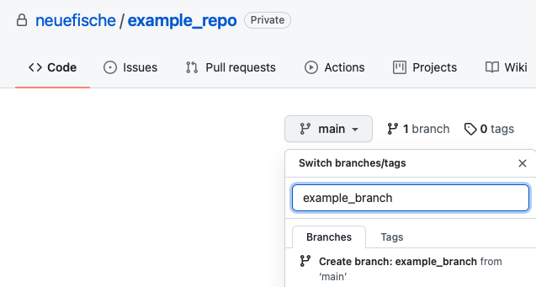
Branch
Let’s get started!
A branch: Work in a parallel version without messing up original
Pull Request: with main once everything is fine
Merge: pull request once approved to combine
Main-branch: (in the past called master)
The center. Every branch should finally merge with main

Slide 11
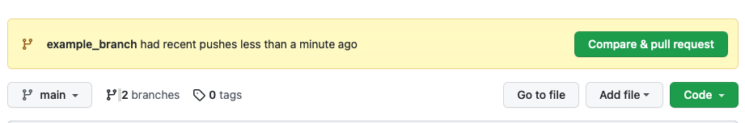
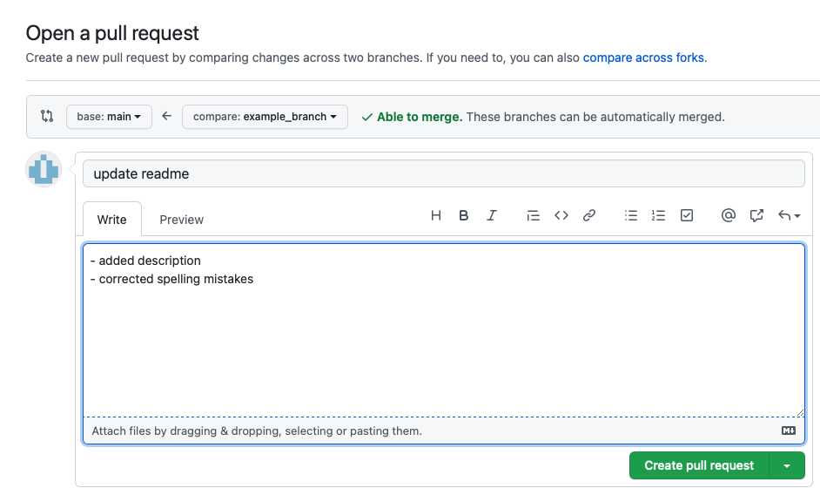
Pull Request
Let’s get started!
A request for changes to be included into the main branch
Notifies other team members that they need to review your changes
During review, you can discuss and review the potential changes with collaborators and add follow-up commits before your changes are merged into the main branch

Slide 12
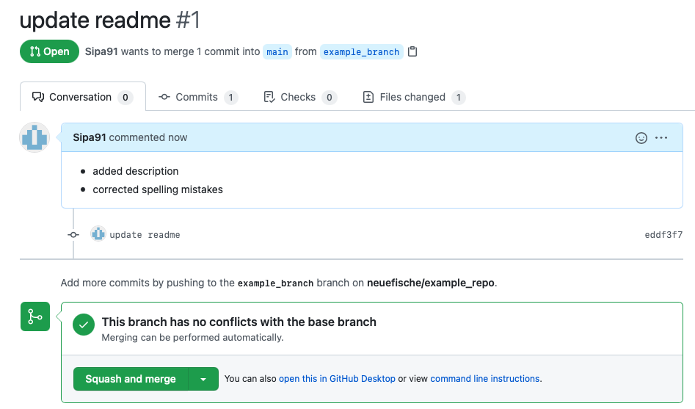
Pull Request
Let’s get started!
First person does the pull request
Second person reviews and accepts
First person does squash and merge
And delete the branch-(you can review your own pull requests)

Slide 13
Merge Conflicts
Let’s get started!
according to GitHub
happen when you merge branches that have competing commits
Git needs your help to decide which changes to incorporate in the final merge

Slide 14
Protocol Process
Let’s get started
Class is required to write a protocol for each day.
Workflow:
Students take turns being the note taker
At the end of each day, the person whose turn it is should:
Create a new branch in the protocol repo
Create a new markdown document and complete draft
Create a pull request
In the daily review the following morning:
Whole class reviews (verbally), adds content questions and recommends changes (via branch)
Pull request is updated with new commits
A couple people ‘Approve’
Writer merges and deletes branch
Template: https://github.com/spiced-academy/da-vanilla-queries-protocol

Slide 15
Step By Step
Go to your repository’s main page
Open your repo: https://github.com/neuefische/da-protocol-nf-da-onl-en-270525
2. Click the branch selector (top-left, says main)
Click it, and you’ll see an input field that lets you type a branch name.
Type your new branch name (e.g. day_01_protocol)
GitHub will say: "Create branch: day_01_protocol from ‘main’” — ✅ click that!
🎉 Now you’re on your new branch.
3. Click “Add file” → “Create new file”
Name your new file something like: day_01_protocol.md

Slide 16
4. Write your content
Add your notes or daily review in Markdown format.
5. Scroll down and commit
Add a message like: "Create day_01_protocol.md"
Select: ☑️ Commit directly to the day_01_protocol branch
6. Create a Pull Request
Now that your branch has a new file, click "Compare & pull request".
Add a description and submit the pull request for review (if needed).
Delete the branch after merging to main

Slide 17
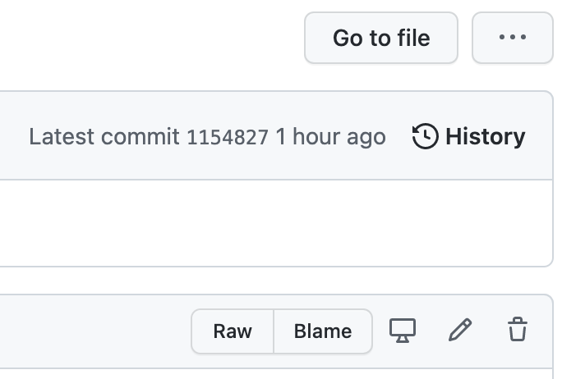
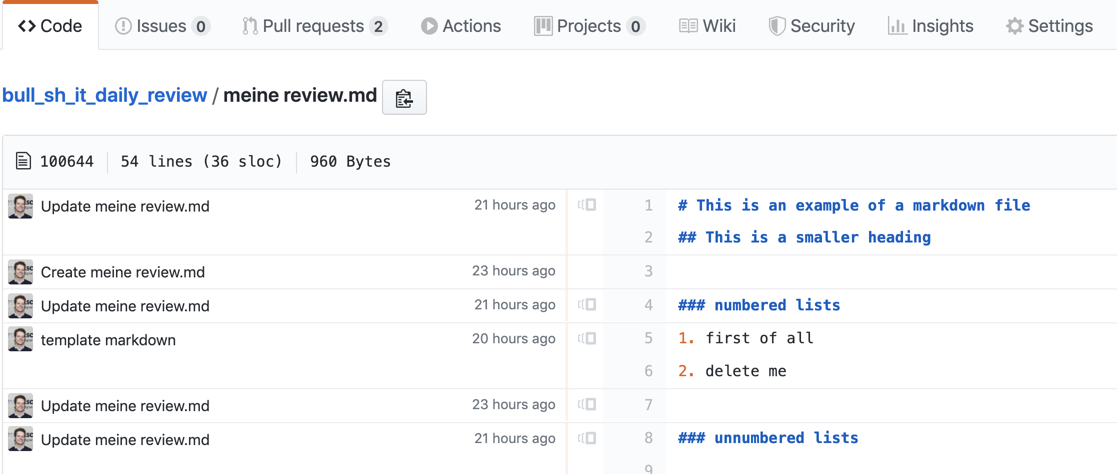
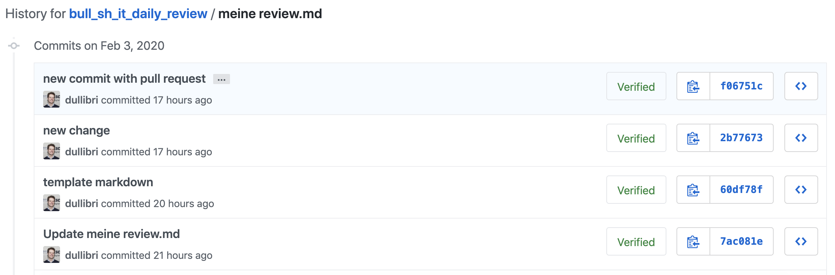
History
Let’s get started!
Go back to previous versions
Look, who added what when

